Slide 2
Azure Active Directory is not Active Directory
Sam Cogan
Solution Architect, Willis Towers Watson & Azure MVP

Slide 3

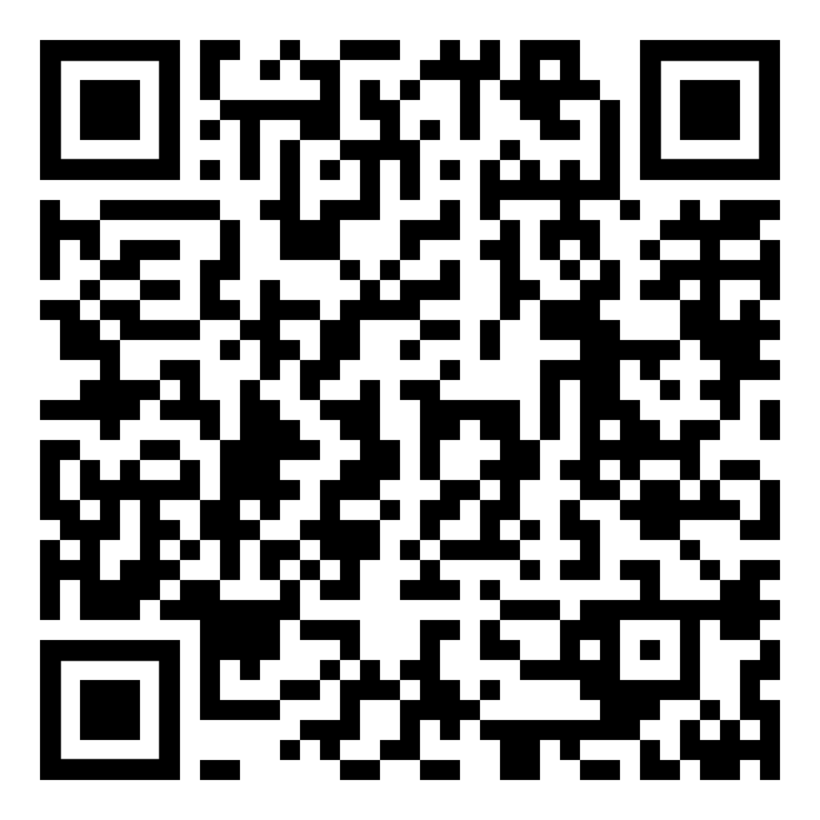



About Me
Sam Cogan
Solution Architect – Willis Towers Watson
Microsoft Azure MVP
samcogan.com
@samcogan
sam-cogan

Slide 4


Azure Active Directory is not Active Directory
Azure Active Directory

Slide 5





What does Azure AD Provide
Cloud Based Identity Store
Application Identity Store
Modern Authentication Protocols
Identity Protection
Collaboration

Slide 6




What doesn’t Azure AD Provide
Group Policy
Domain Join and Machine Management
LDAP, NTLM, Kerberos
OUs, Forests, Trusts
Extensible Schema

Slide 7
Working with AAD and On-Premises

Slide 8
Azure AD Only

Slide 9
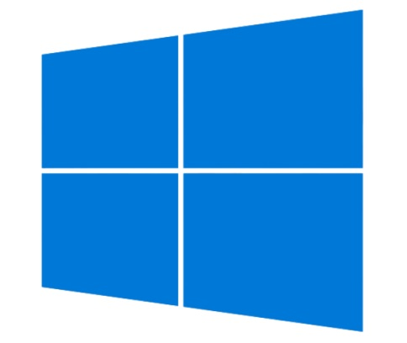




Extending Azure AD
Windows 10 AAD Join
Intune
Azure DNS
Azure Files/NetApp Files

Slide 10
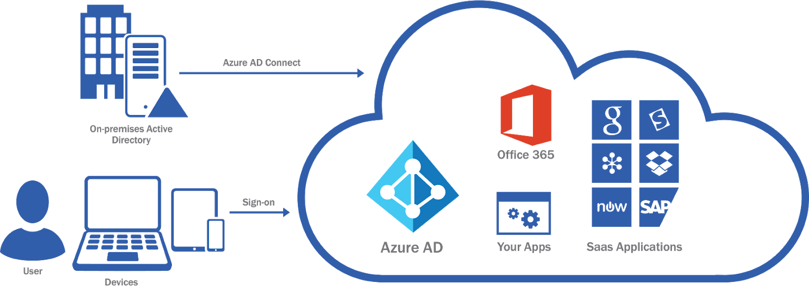
Hybrid

Slide 11
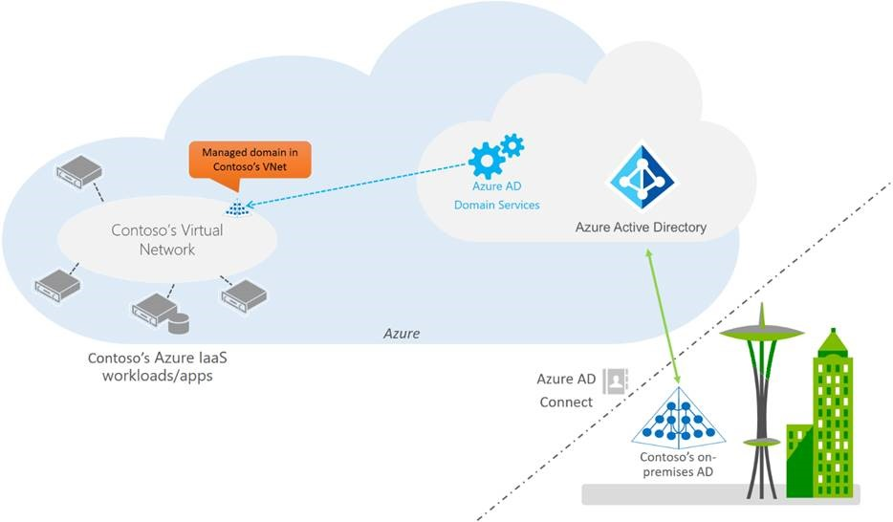
Azure AD Domain Services

Slide 12

IaaS Domain Contollers

Slide 13
Azure Active Directory is not Active Directory
Azure Active Directory

Slide 14
About Me
Sam Cogan
Solution Architect – Willis Towers Watson
Microsoft Azure MVP
samcogan.com
@samcogan
sam-cogan

